Slide 1
How to Launch a Satellite Into Orbit.
Connor Petri

Slide 2
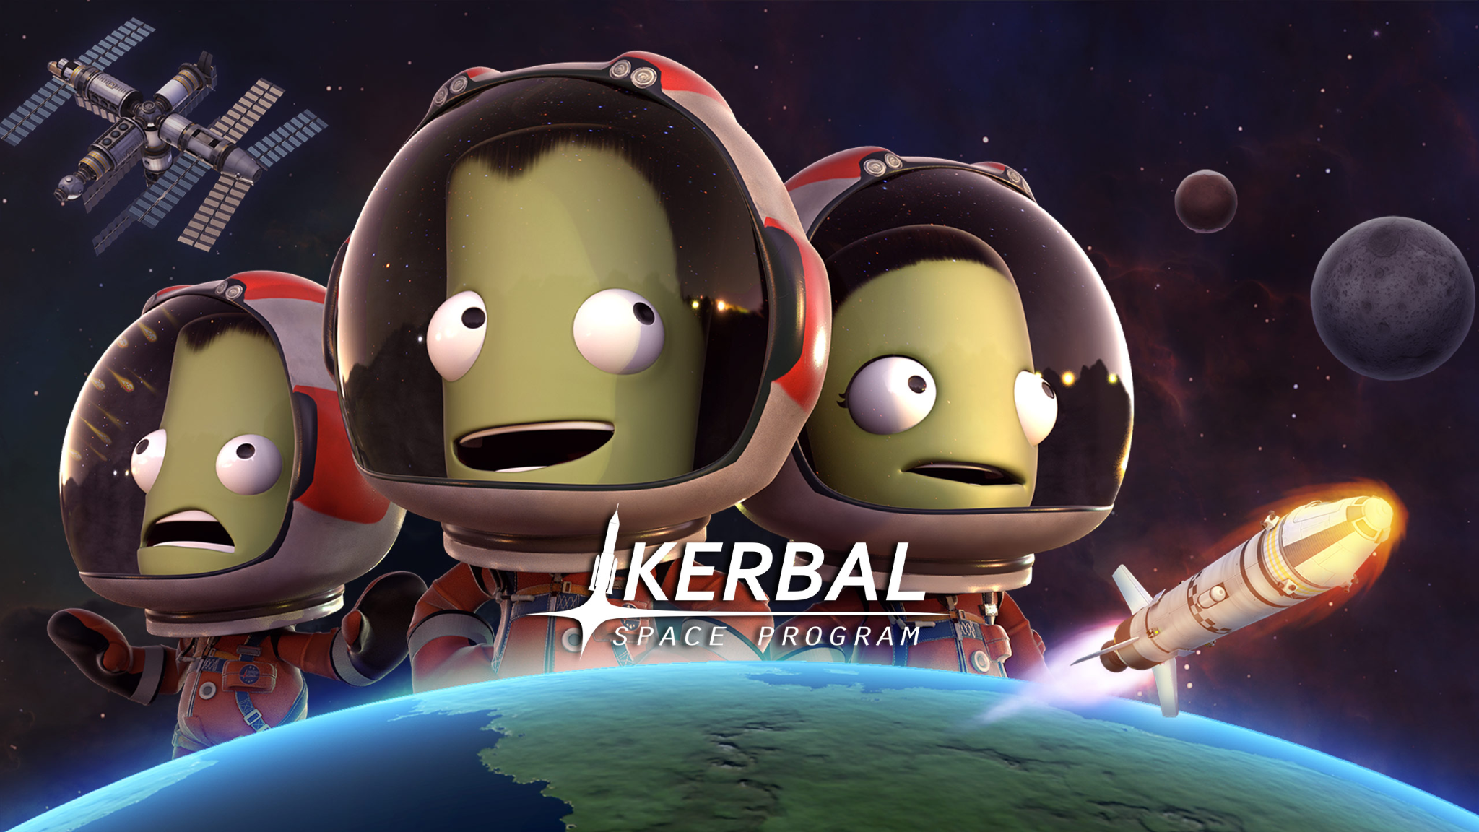

Slide 3
Why am I the expert?
I’m not.
I’m not even a physics major.
I have ~1700 hours in Kerbal Space Program.

Slide 4
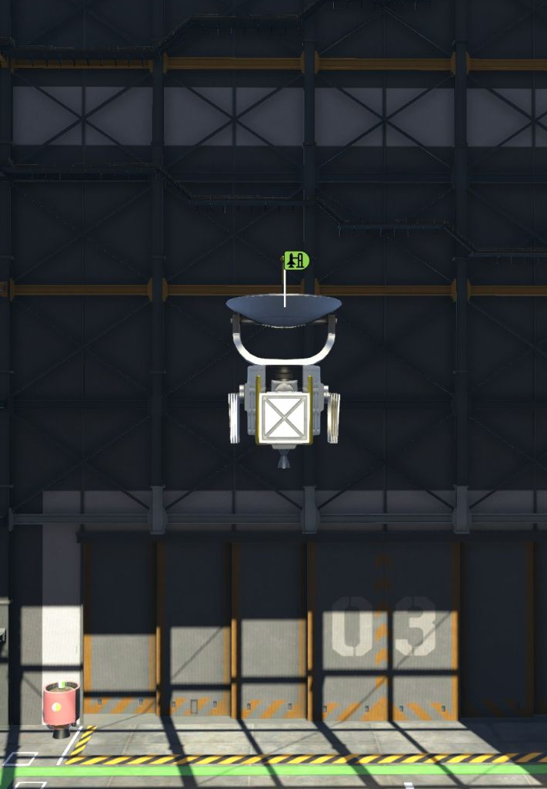
Payload
Whatever you want to put into orbit.
Usually a satellite or a capsule with humans or cargo inside.
Contained inside of a payload fairing, which covers the payload during launch.

Slide 5
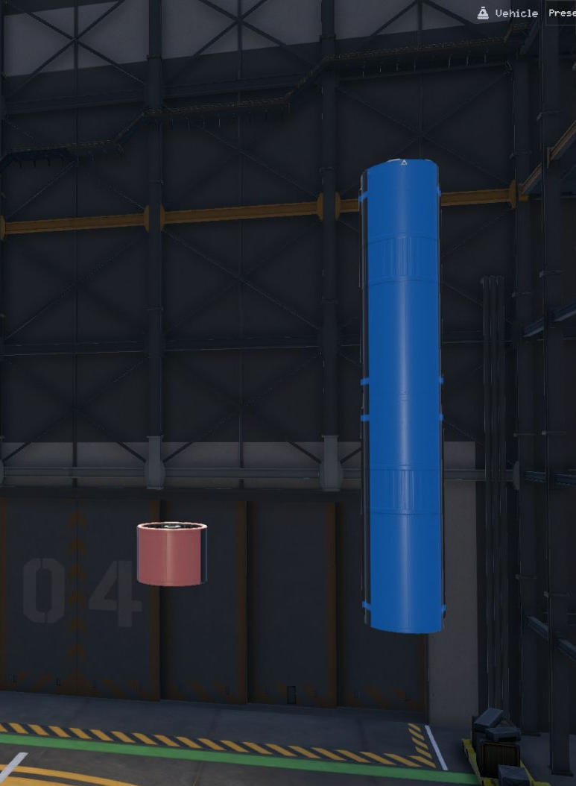
Fuel Tanks
Contains liquid methane or another rocket fuel and liquid oxygen (LOX).
We have to carry our own oxidizer for combustion to take place, as there is no air in space.

Slide 6
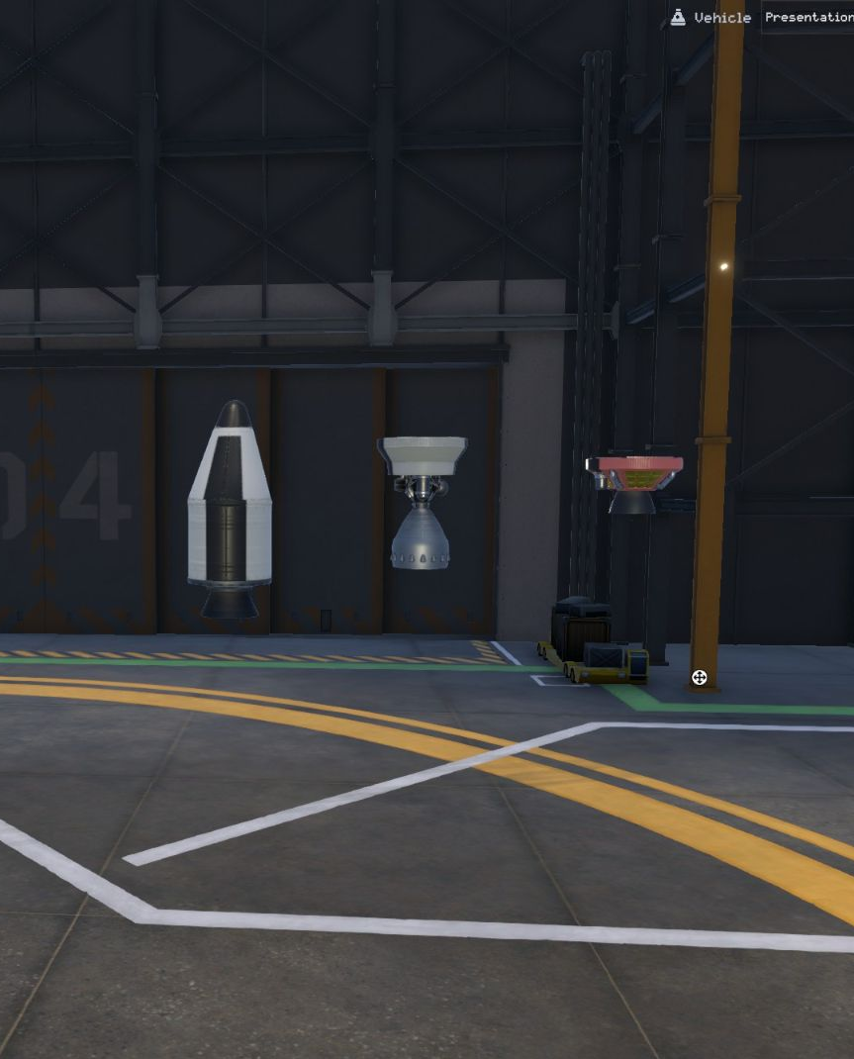
Engines
Turns fuel and oxidizer into thrust.
Different engines are meant to work at different altitudes.
Solid rocket boosters are lit once and burn until they run out.

Slide 7
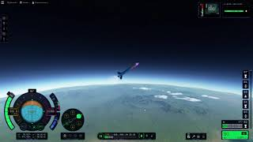
Getting into orbit.

